Slide 1
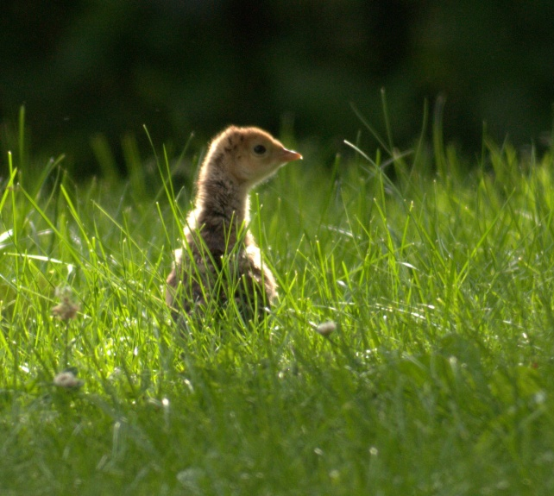
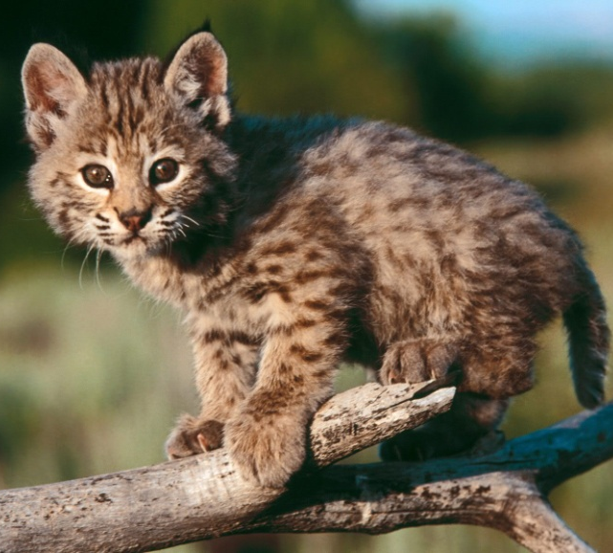
Animals & Habitats
Lindsay Rogers
Nebraska Game & Parks Commission

Slide 2
Habitats
Food
Water
Shelter
Space
Air

Slide 3
Habitats: Food
The food an animal requires depends on the animal…
Herbivore
Carnivore
Omnivore

Slide 4
Habitats: Water
All living things need water!
Water can come from many sources:
Lake, puddle, stream, river, pond, and even their food!

Slide 5
Habitats: Shelter
The kinds of shelter depend on the animal….
Under bark
Under a pine tree
In a burrow
In a hallow tree
In a lake or pond
Under a rock
In the grasses
Shelter also depends on the time of year!

Slide 6
Habitats: Space
Space provides air, movement, and enough resources.
We can all fit in a closet, but we cannot all live in a closet!

Slide 7
Habitats: Air
All living things need air… either oxygen or carbon dioxide.
Animals – oxygen
Plants – carbon dioxide

Slide 8
Habitats
How do animals live and survive in their distinct habitat?

Slide 9
Habitats
Nebraska has LOTS of different kinds if habitats:
Shortgrass Prairie
Mixedgrass Praire
Tallgrass Prairie
Wetland
Forest
Urban
Farmland
Lakes & Ponds
Rivers & Streams

Slide 10
Habitats
Some animals can live in many different habitats...
Coyote
Raccoon
Fox Squirrel
Turkey
Skunk
Crows

Slide 11
Habitats
Other animals require a very specific habitat...
Fish
Frogs
Prairie Dogs
Ducks
Dragonflies
Flying Squirrels

Slide 12
Habitats
What about a mountain lion? What is its habitat?
Food?
Water?
Shelter?
Space?!!

Slide 13
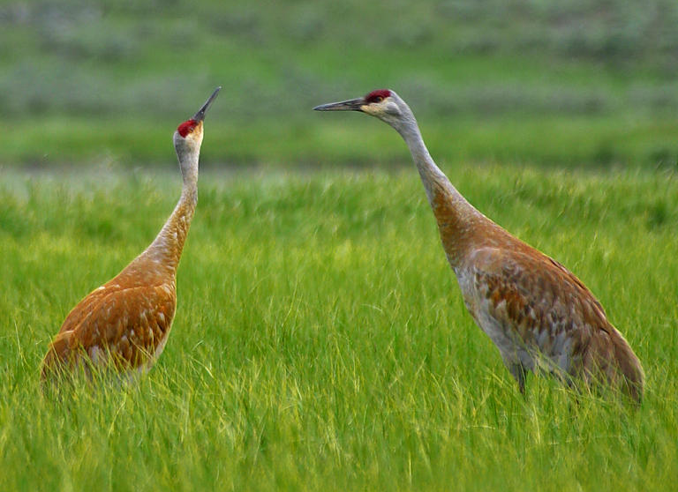
Habitats
What about a Sandhill Crane? What is its habitat or habitats?
Food?
Water?
Shelter?
Space?

Slide 14
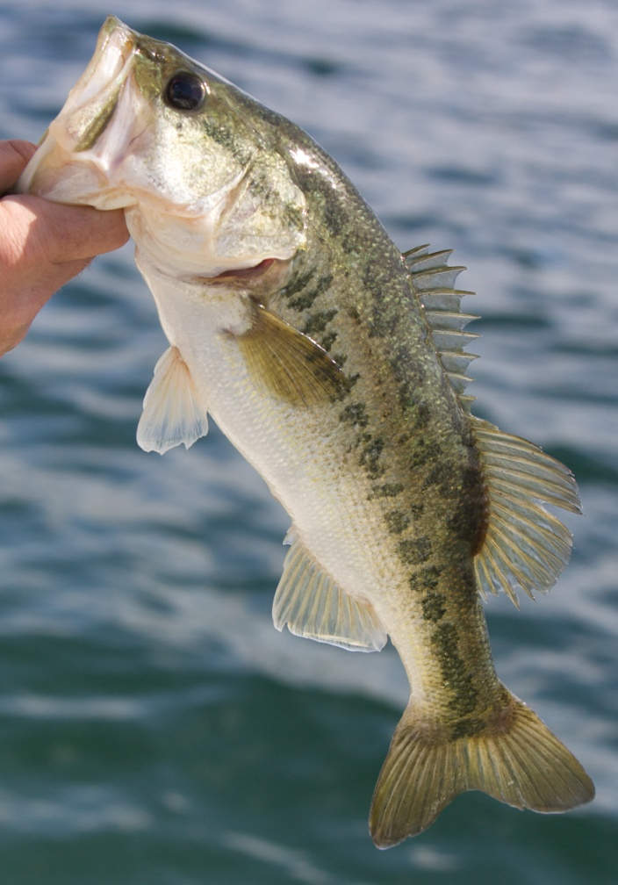
Habitats
What about a bass?
What is its habitat?
Food?
Water?
Shelter?
Space?

Slide 15
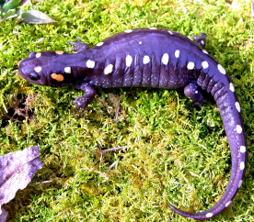
Habitats
What about a salamander? What is its habitat?
Food?
Water?
Shelter?
Space?

Slide 16
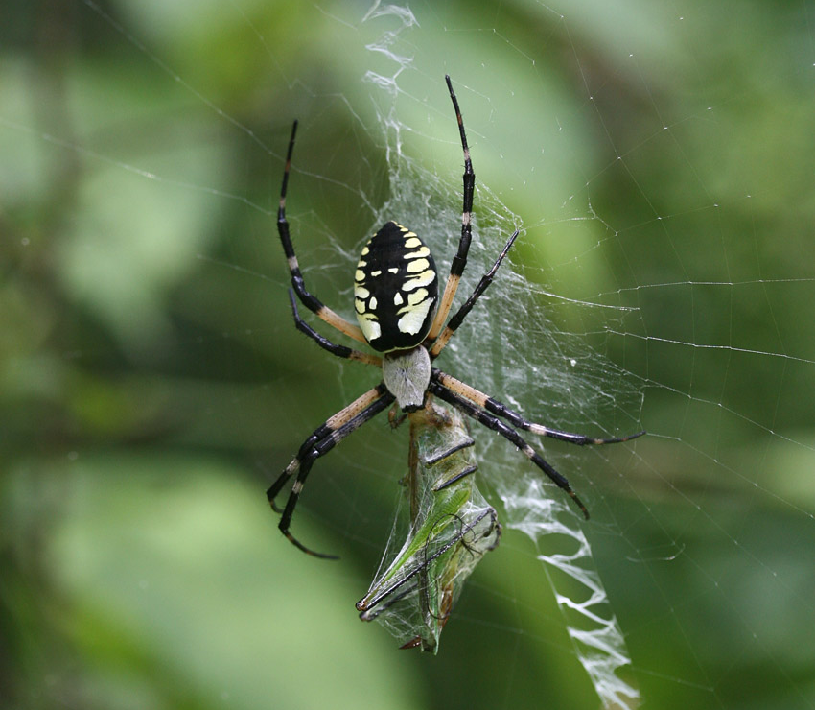
Habitats
What about a garden spider? What is its habitat?
Food?
Water?
Shelter?
Space?

Slide 17
Compare and Contrast Animals
Let’s look at body coverings, diet, and locomotion!

Slide 18
Body Coverings
Mammals have fur or hair… always!
Even dolphins and whales have tiny hairs covering their body.

Slide 19
Body Coverings
Reptiles have scales… always!
Turtle
Snake
Crocodile
Alligator
Lizard

Slide 20
Body Coverings
Amphibians have skin…
very thing skin!
Frog
Salamander
Toad

Slide 21
Body Coverings
Insects have a hard exoskeleton…
They do not have a backbone, this exoskeleton protects their insides!

Slide 22
Body Coverings
Birds have feathers…
Always!
They have lots of different kinds of feathers:
Flight, down, body, etc.

Slide 23
Body Coverings
Fish have scales…
Always!

Slide 24
Body Coverings
Fish have scales…
Always!

Slide 25
Diet
Carnivores
(sharp teeth)
Omnivores
(some sharp teeth, some flat teeth)
Herbivores
(flat teeth)

Slide 26
Locomotion
Walking, galloping, running, hopping, jumping, flying, crawling, soaring, swimming, slithering, sliding,……..

Slide 27
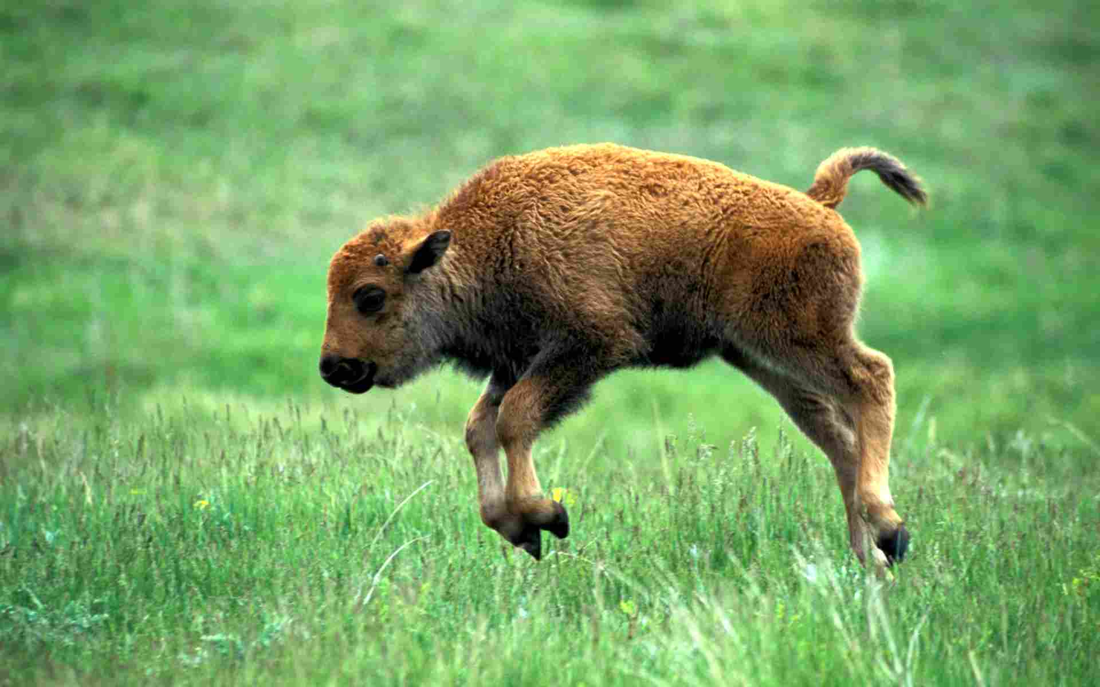
Questions?

